Slide 1

ENPM665 – Cloud Security
Syed Mohammad Ibrahim
iamibi@umd.edu
UID: 118428369

Slide 2
Introduction
The current application is deployed on-prem which adds a heavy cost to our architecture maintenance.
Previously, a proposal was provided to migrate our current architecture to cloud.

Slide 3
Key Takeaways
Application configurations to migrate the current application to AWS Cloud
A new application architecture to handle concurrency, large data storage, on-demand scaling and multi-region support available
Automated configuration and deployments through Terraform

Slide 4
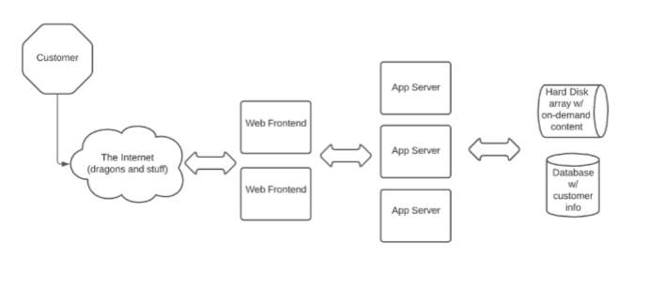
Current Architecture Issues
The current architecture doesn’t perform well under load
The application currently doesn’t have any security definitive architecture like role-based authentication and authorization
Availability is in question as the active userbase grows
Audit trail is not possible when the application doesn’t work as expected and debugging is required or if there is a security incident

Slide 5
Proposed Architecture
Version 1.0
Deploying the application on an AWS EC2 instance
Add Application Load Balancer to handle concurrent request
AWS S3 buckets to store log information, assets, videos, etc.
Remote database cluster(s) to handle user information
Third-party vendor Brain-Tree to be integrated for payment solution over multiple regions. This will also help us in maintaining PCI compliance to process credit cards
Auto-Scaling AWS EC2 instances on-demand for high availability
Adding security groups and IAM role policies for developers and system admins
Multi-Factor authentication to authenticate employees, executives and system admins

Slide 6
Proposed Architecture (Cont.)
Version 2.0 [Draft]
Add support to more regions
AWS Orchestrator Service to add support for GDPR, CCPA, and other types of standards and policies
Region based IAM policies

Slide 7
Tools
Deploying to AWS manually can be complicated and is error prone
Automated workaround required to mitigate the risks
Proposed tool for automation: Terraform
Terraform is an Infrastructure-as-a-Code service that allows us to configure a cloud provider through their APIs

Slide 8
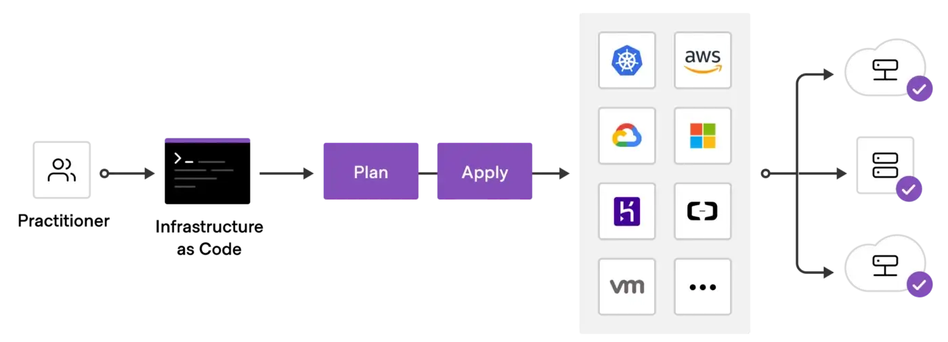
Terraform Flow

Slide 9
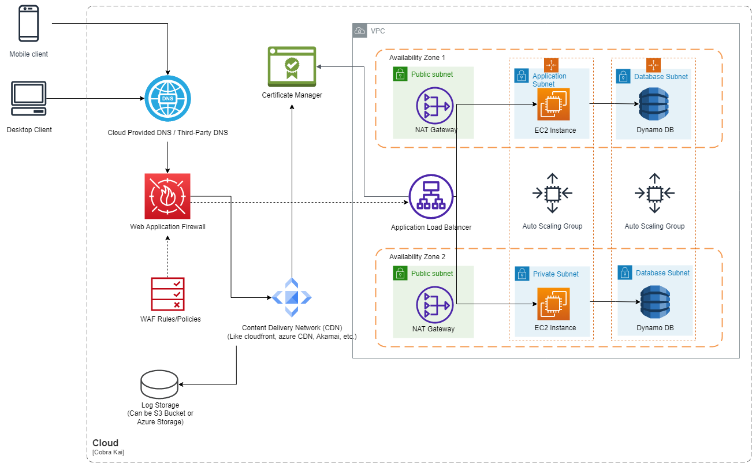
Planned AWS Cloud Architecture Diagram

Slide 10
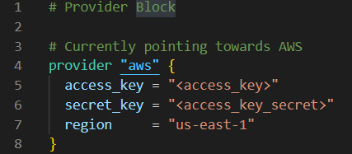
Provider Attachment
Terraform provides multi-cloud provider integration and configuration support
We can create a provider block with a dedicated cloud provider (AWS in our case)
Adding the access_key and secret_key will be required of the AWS account that we will be using to deploy an EC2 instance
Current region is set to us-east-1

Slide 11
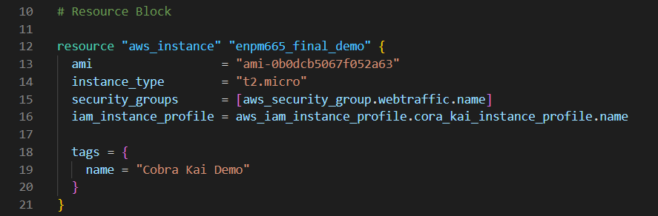
AWS Instance Resources
The resource group “aws_instance” in terraform allows attaching configuration values to the deployed AWS EC2 instance(s)
This specific block requires an AMI id which can be obtained by creating an instance AWS EC2 in a specific region
The AMI Id is dependent on the region, the application will be deployed to
Security groups can be added as a list to tie them to current EC2 instance that we are configuring
AWS IAM roles are added as part of the instance to make sure that only the allowed roles have allowed access to their respective resources

Slide 12
AWS S3 Buckets
AWS S3 buckets are helpful in storing a large volume of data
We can adjust the size of S3 buckets depending on our usage
The S3 buckets are going to be used for storing application deployment logs, error logs and access logs
A backup of all the logs will be created automatically after a decided interval and archive operation will be performed to make sure that important information is available
S3 buckets will be available within a VPC connection which will only be accessible by our companies VPN service provided to the employees, executives and system admins
Authentication attempts can be logged to verify whether a malicious actor is trying to perform brute-force on any user/employee available on the application

Slide 13
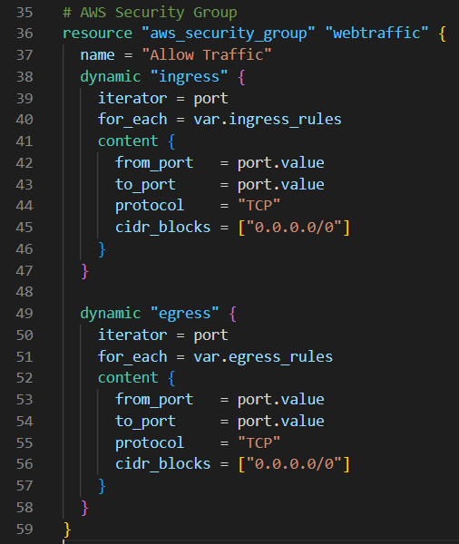
Security Policies
Terraform allows the configuration of Security Policies like the application ingress and egress rules
ingress rules currently are set to accept traffic from port 80, 5000 and 443 (TLS)
egress rules currently support outgoing web traffic from port 80, 5000, 443 and 25 (Email)
Port 25 is expected to be configured for sending out email communications to users for offers, identity confirmation, etc. and for employees/execs/sys_admins to inform them about policy changes, IAM role changes, incidents, etc.

Slide 14
PCI Compliance
We will be using brain-tree as our payment gateway to manage payments on our application
Brain Tree is Level 1 PCI Compliant
Using their solution will help us mitigate the risks of handling the sensitive payment-based information

Slide 15
Development Standards
Using a Version Control System like GitHub or GitLab to maintain a repository for the web application code
After every release, S3 storage can be used to create an archive of the release build by making a clone from VCS branch
Archiving can be achieved using tools like Amazon S3 Glacier

Slide 16
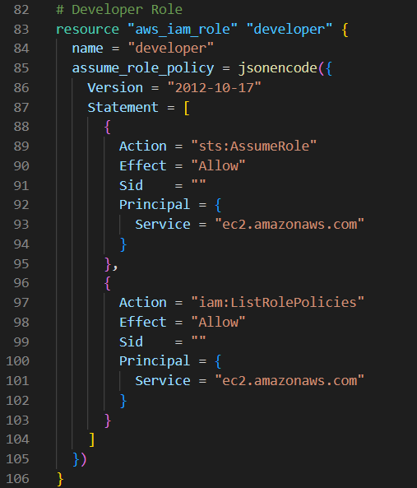
IAM Roles
Terraform allows adding specific roles through “aws_iam_roles” resource
Here, we have a “developer” role which has “AssumeRole” and “ListRolePolicies” access set
Additional role-based actions can be added depending on the organization growth and access requirement
A sys_admin role is also available which will have all the access of the cloud. This role will be provided only to specific people within the organization

Slide 17
Database
Amazon provides multiple database options like Amazon Redshift (SQL based DB) and Amazon Dynamo DB (NoSQL based DB)
For our use case, we can have the primary database as Amazon Dynamo DB since scaling is our primary goal in terms of users
Having a NoSQL db will help in ad-hoc data addition
Additional use-case, which involves providing reports to executives can be done through the Amazon Redshift
Dedicated ETLs can be written by the Development team to take a snapshot of the Dynamo DB either everyday or everyweek and the push the information to the Redshift
As SQL based dbs are performance focused, they will provide faster response based on the queries to be executed. A third-party tool like Amazon Quicksight can be made available to the Execs for executing certain types of queries (which will be provided by the development for their use-cases)
Dynamo DB can be encrypted by AWS using Amazon Key Management Service (KMS)

Slide 18
Load Balancing
AWS provides different options of load balancing like:
Application Load Balancer
Network Load Balancer
Classic Load Balancer
Load balancing allows our deployed application to be accessible irrespective of the number of users accessing the application
The traffic is automatically distributed on different systems depending on the number of instances deployed
Usually, load balancing is coupled up with auto-scaling option which help in horizontal scaling

Slide 19
Conclusion
An automated way to deploy AWS instances using Terraform is a good idea
The configurations are expected to be managed by DevOps and Security team to make assure proper setup and deployment
Cost effective configurations can be deployed based on how the requirements progress

